Slide 1
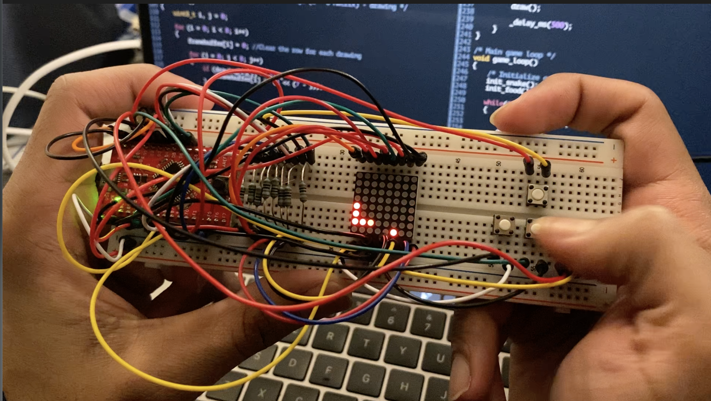
The snake game on Atmega32U4
by Jayendra Ellamathy

Slide 2
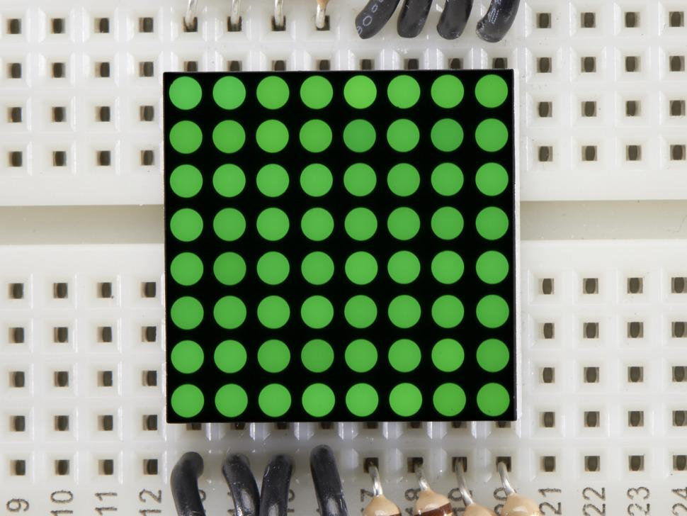
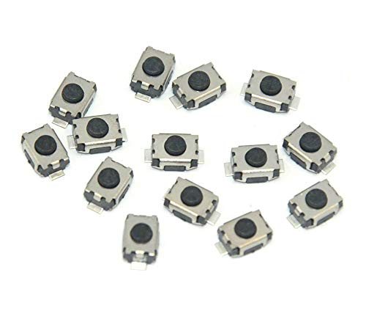
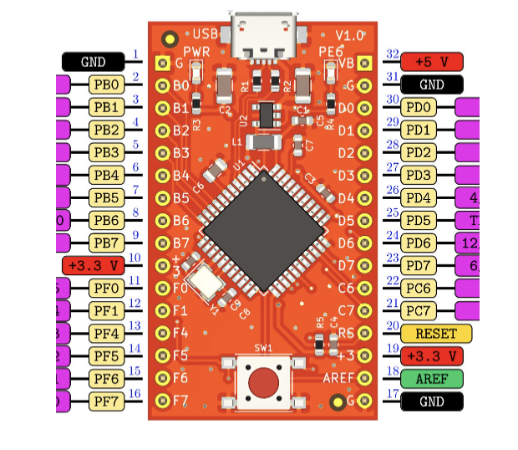
Hardware
Components:
Push buttons
8 * 8 Dot LED matrix
Eduino

Slide 3
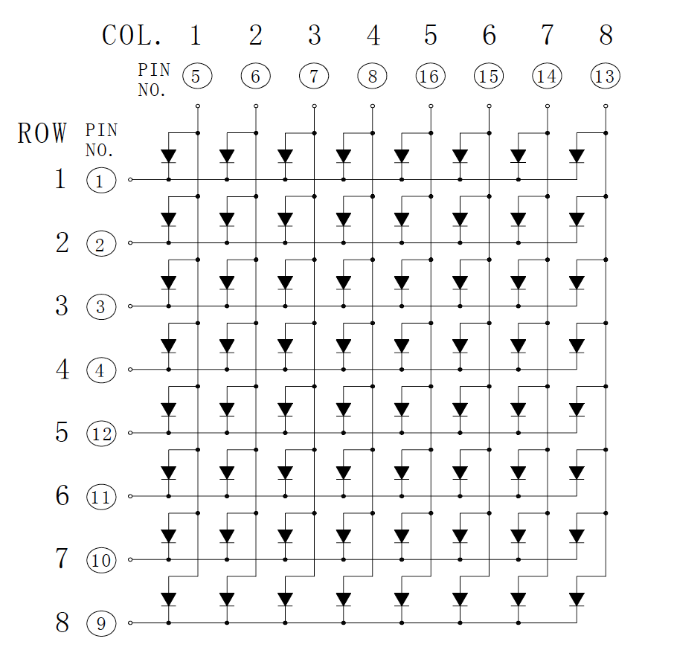
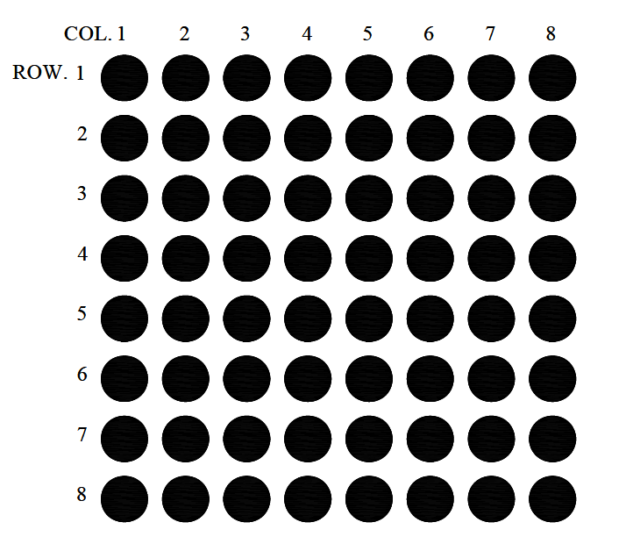
Hardware
Controlling the LED dot matrix
16 GPIO pins
Timer

Slide 4
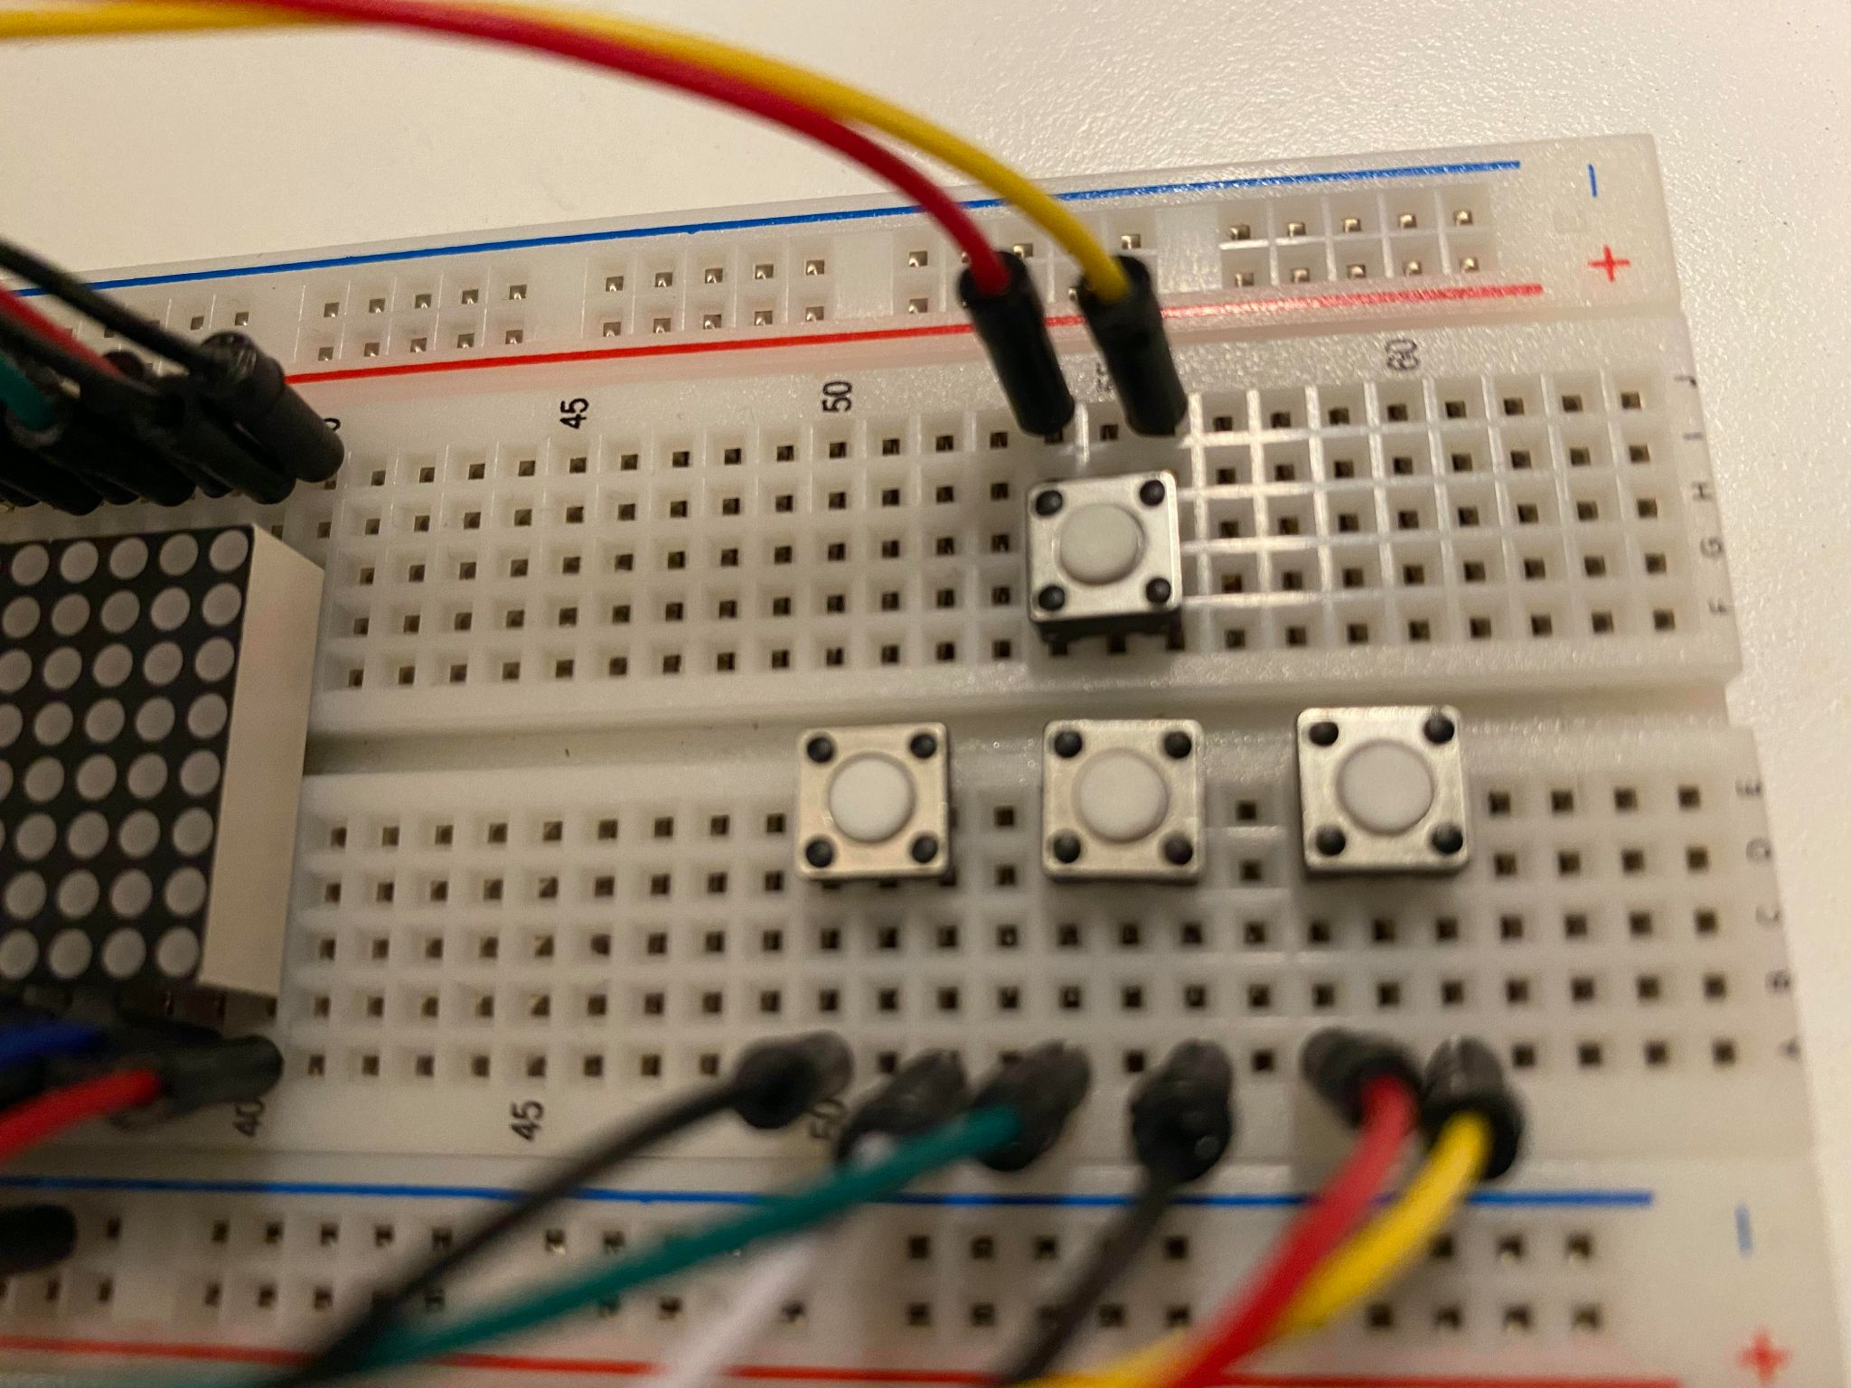
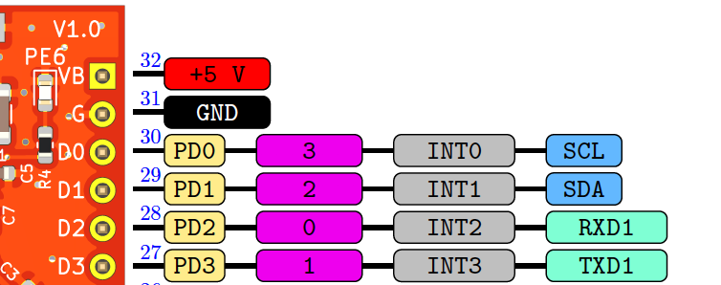
Hardware
Controlling the push-buttons:
External hardware interrupts on PD0..3
Change on pin triggers interrupt

Slide 5
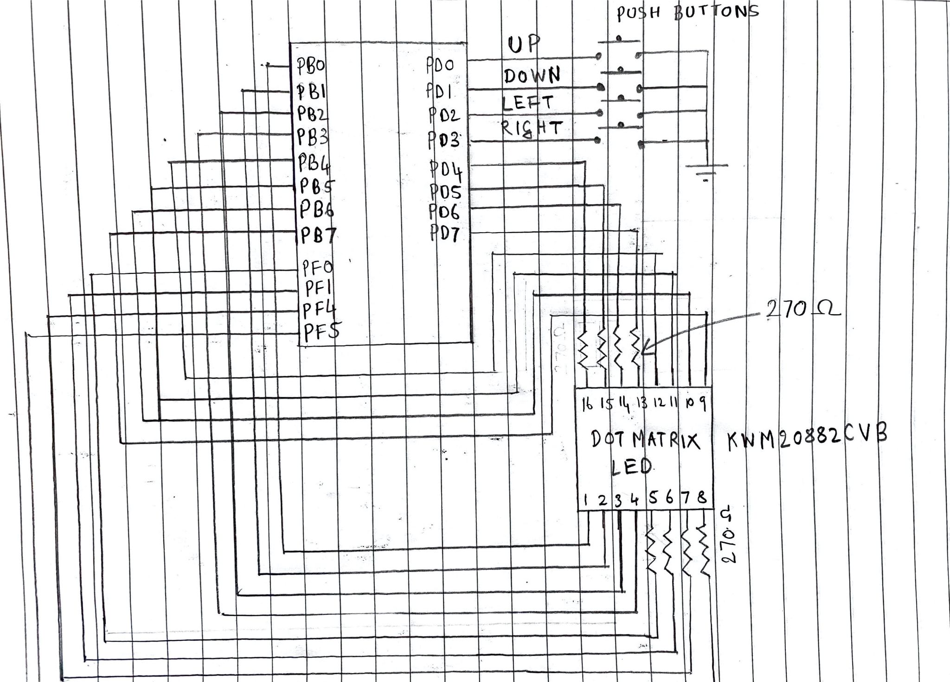
Hardware
Pin diagram

Slide 6
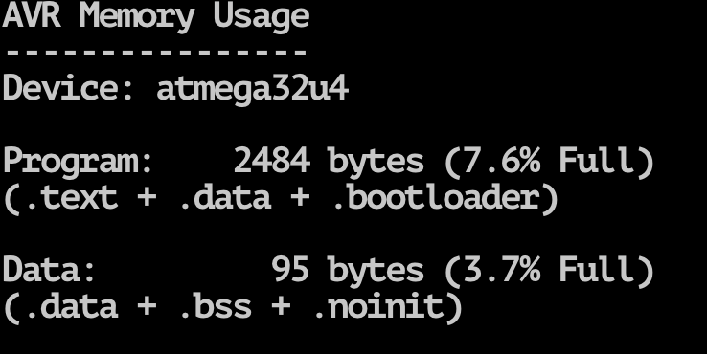
Software
Drawing on the LED matrix
Controlling the push buttons
The snake game
Under 500 LOC :)

Slide 7
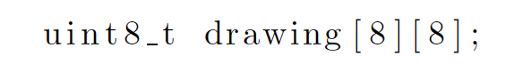
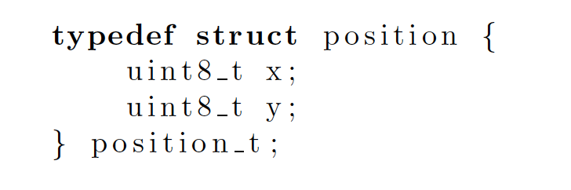
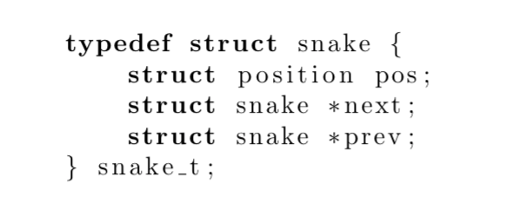
Software
The snake game
Game environment - 2D array of size 8
Snake - linked list

Slide 8
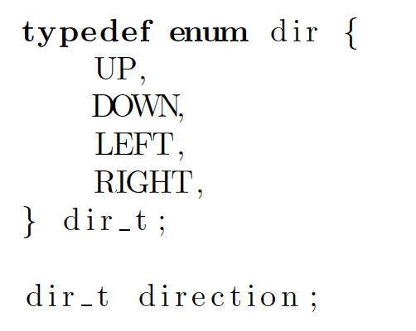
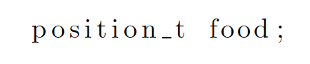
Software
The snake game
Direction
Food

Slide 9
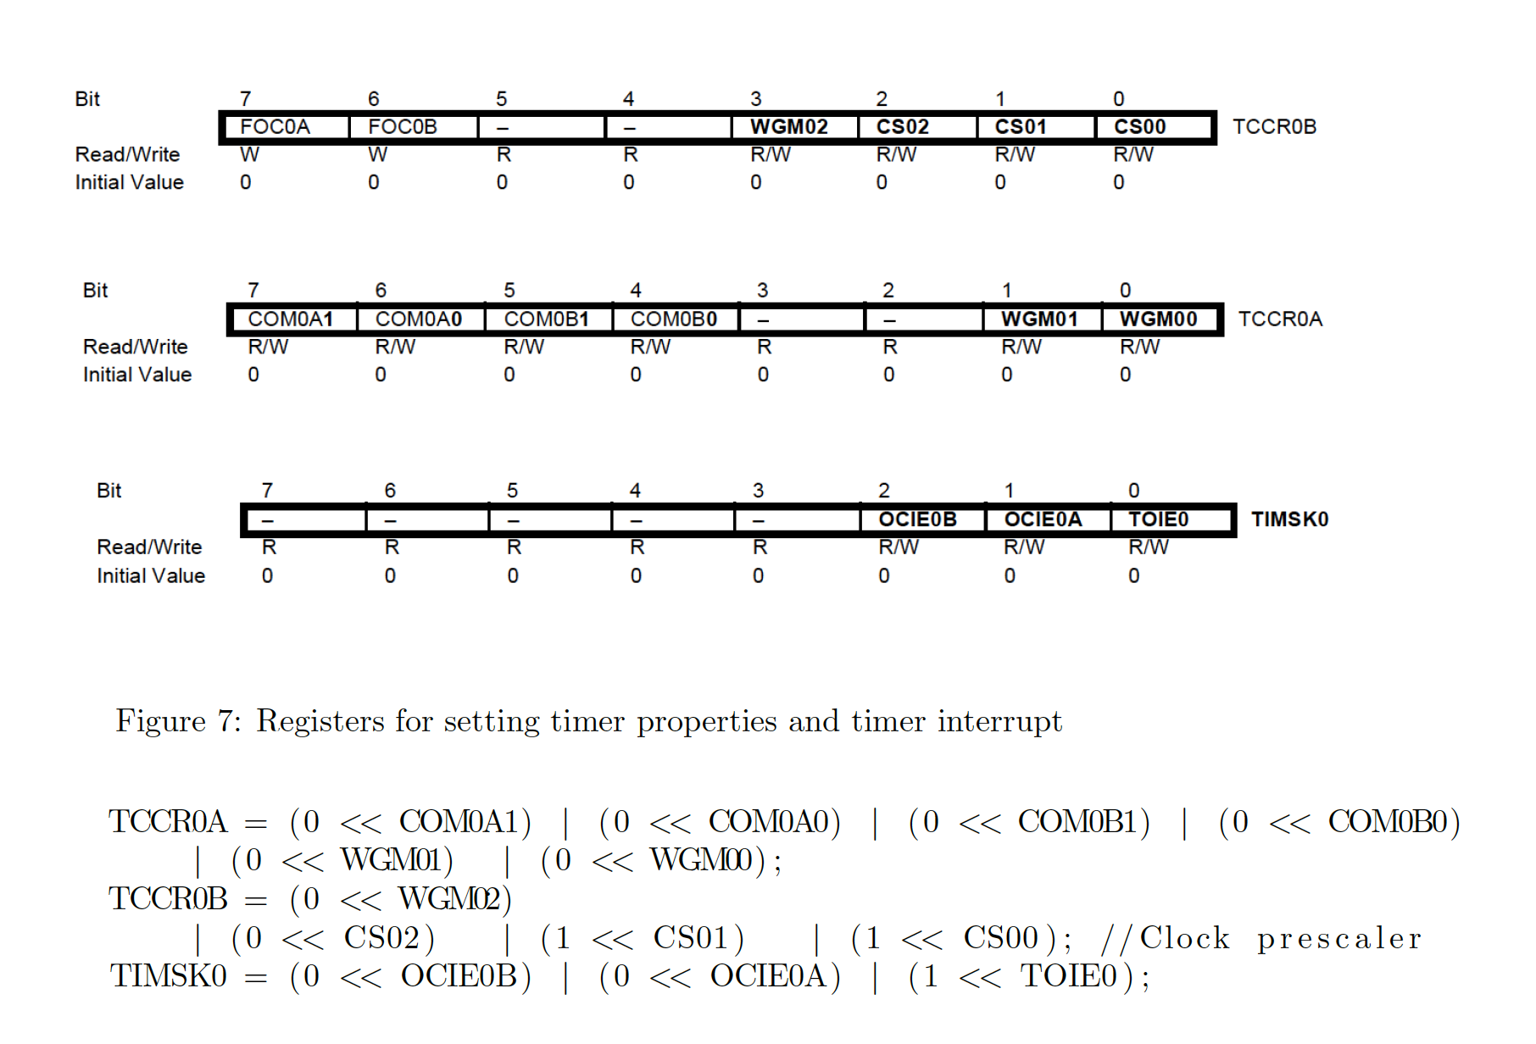
Software
Drawing on the LED matrix
Configuring timer interrupt

Slide 10
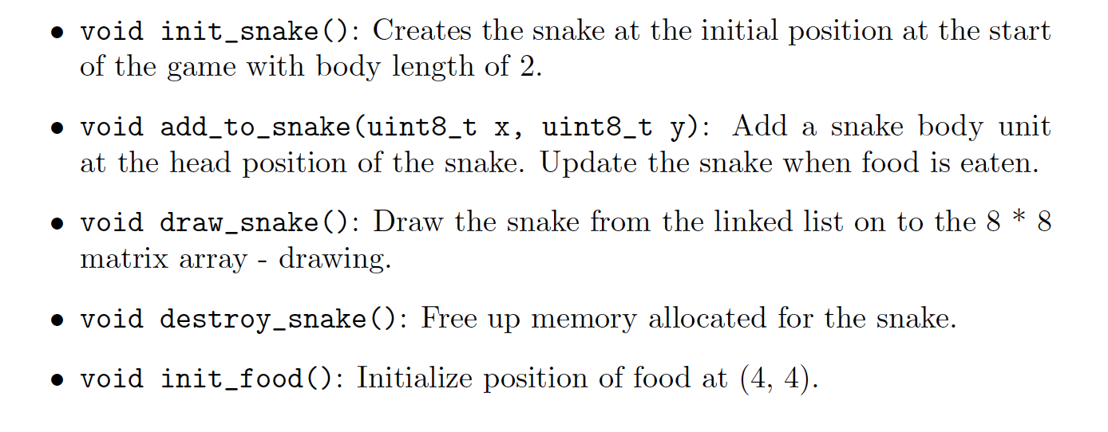
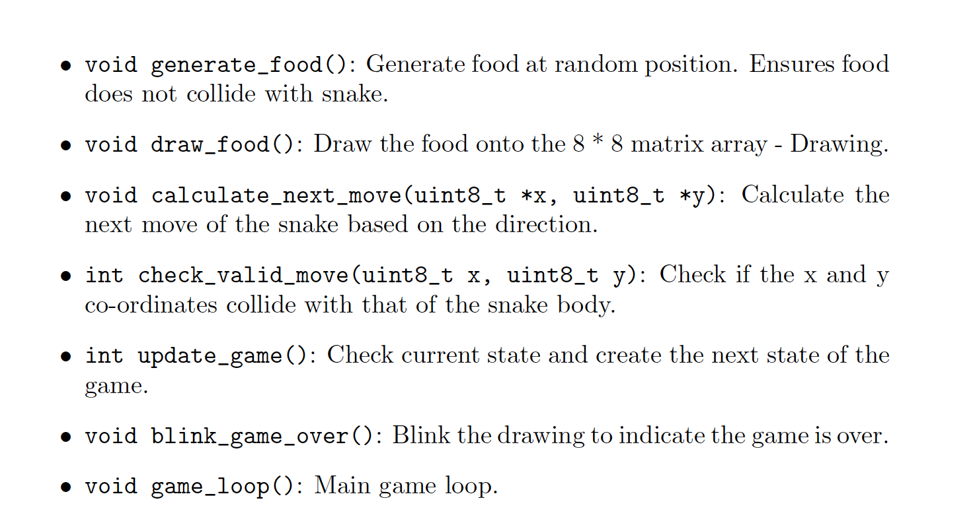
Software
The snake game

Slide 11
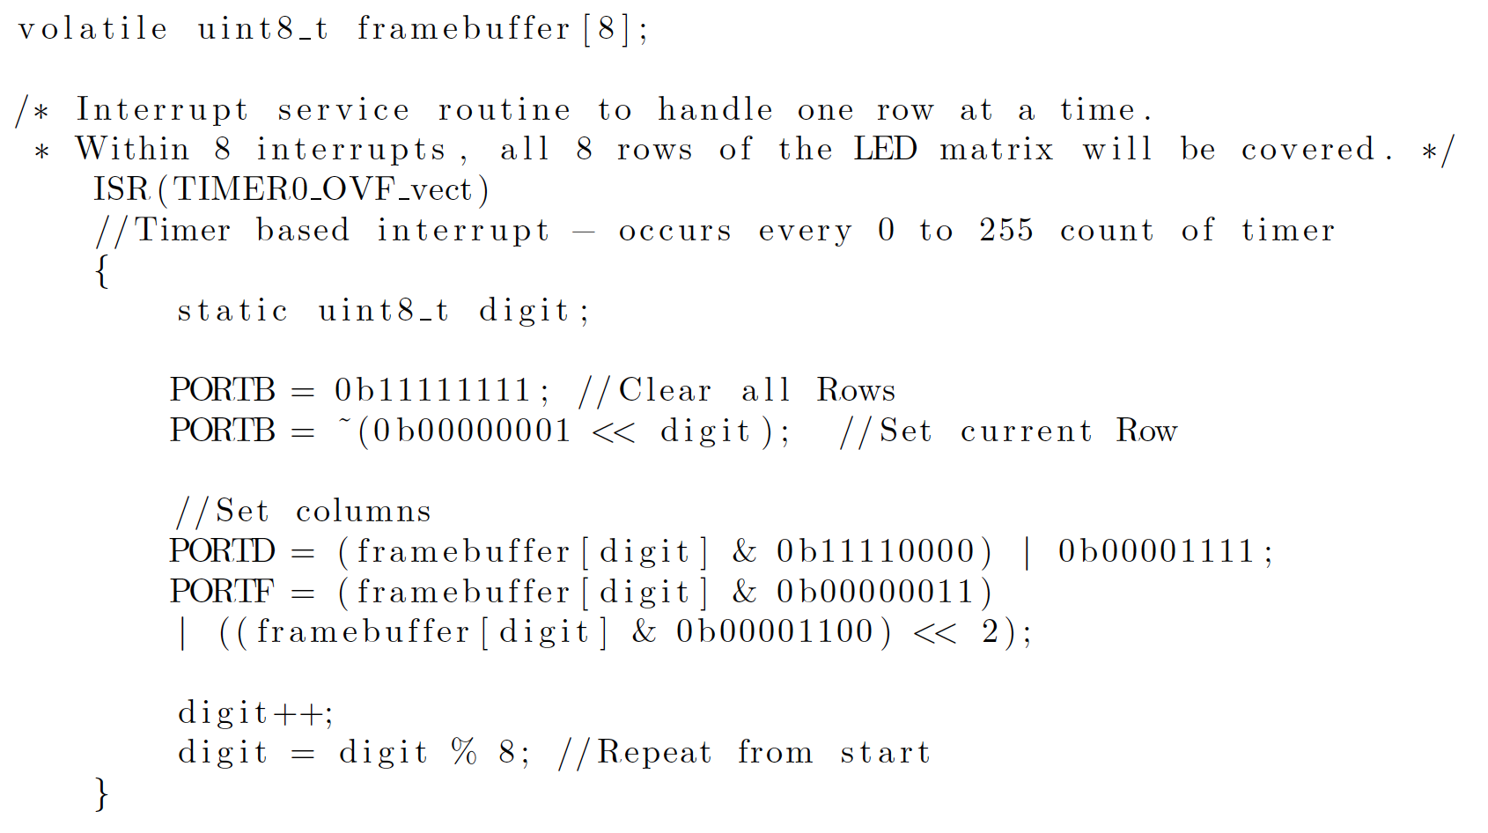
Software
Drawing on the LED matrix
Timer overflow ISR

Slide 12
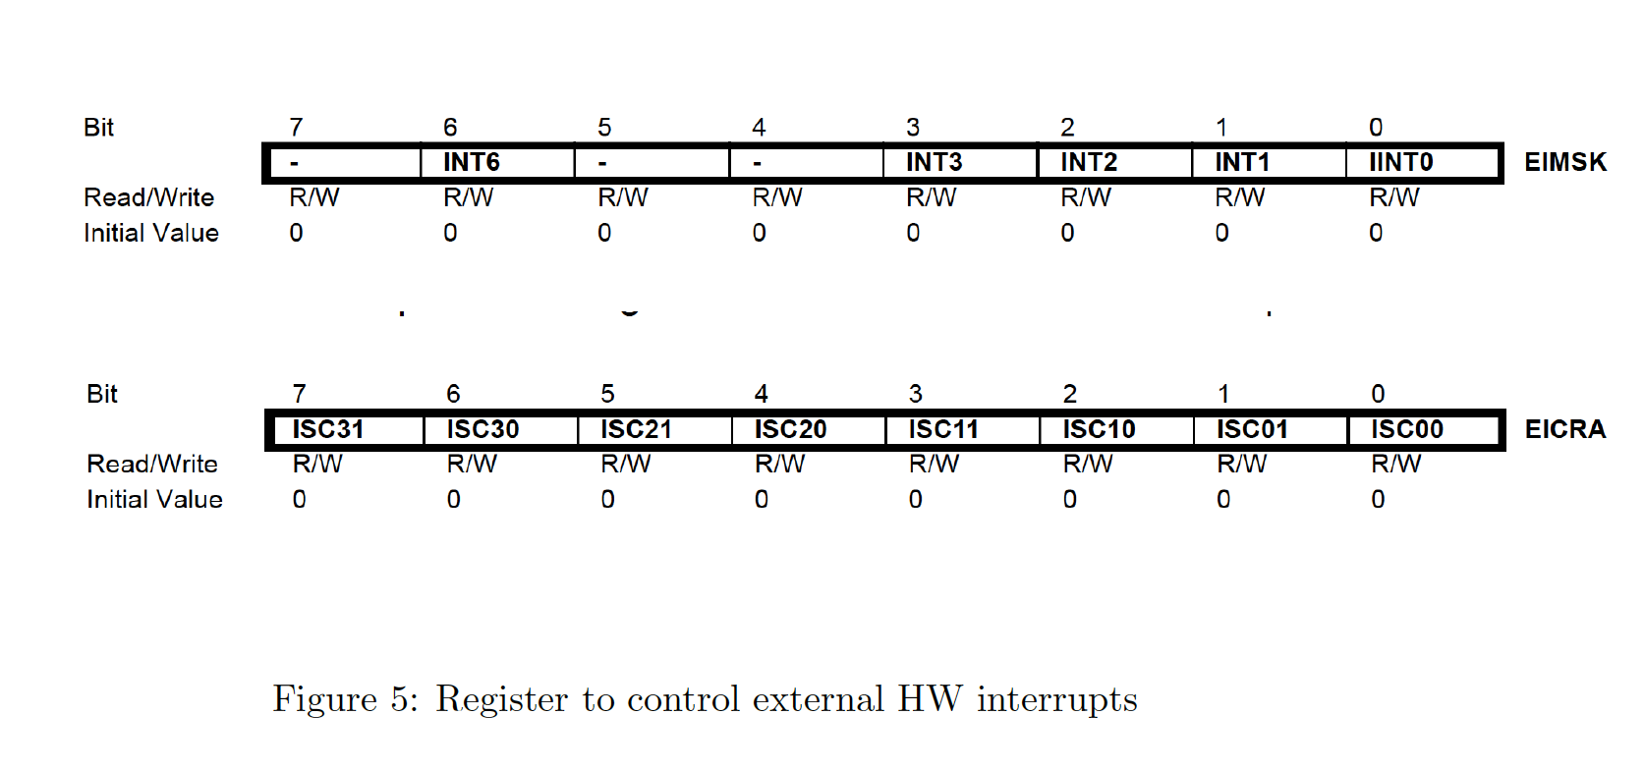
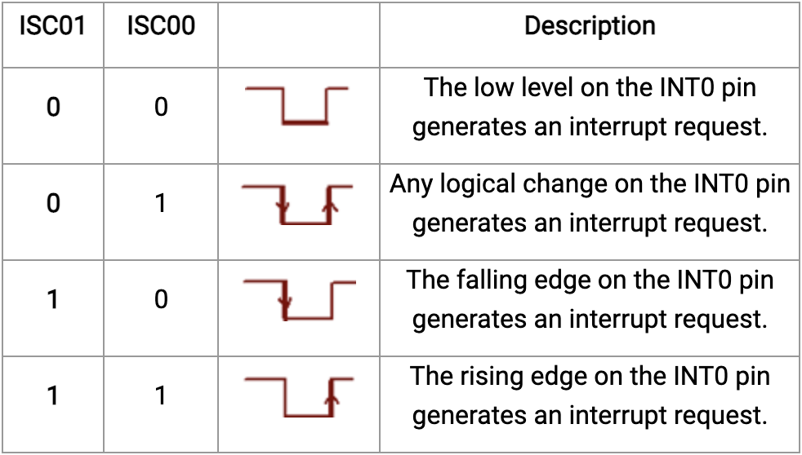
Software
Controlling the push buttons

Slide 13
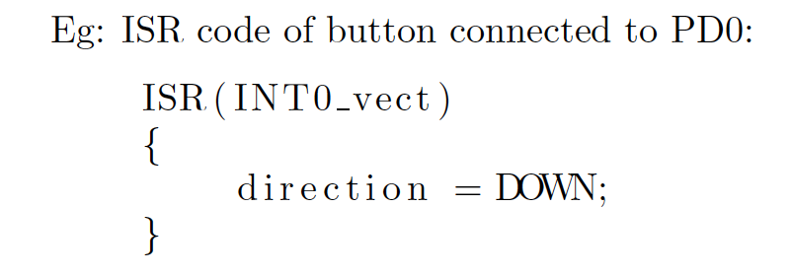
Software
Controlling the push buttons

Slide 14
Thank you!
Questions?

